Slide 1
CrowdFunding Analysis
Subcategory ‘Plays’

Slide 2
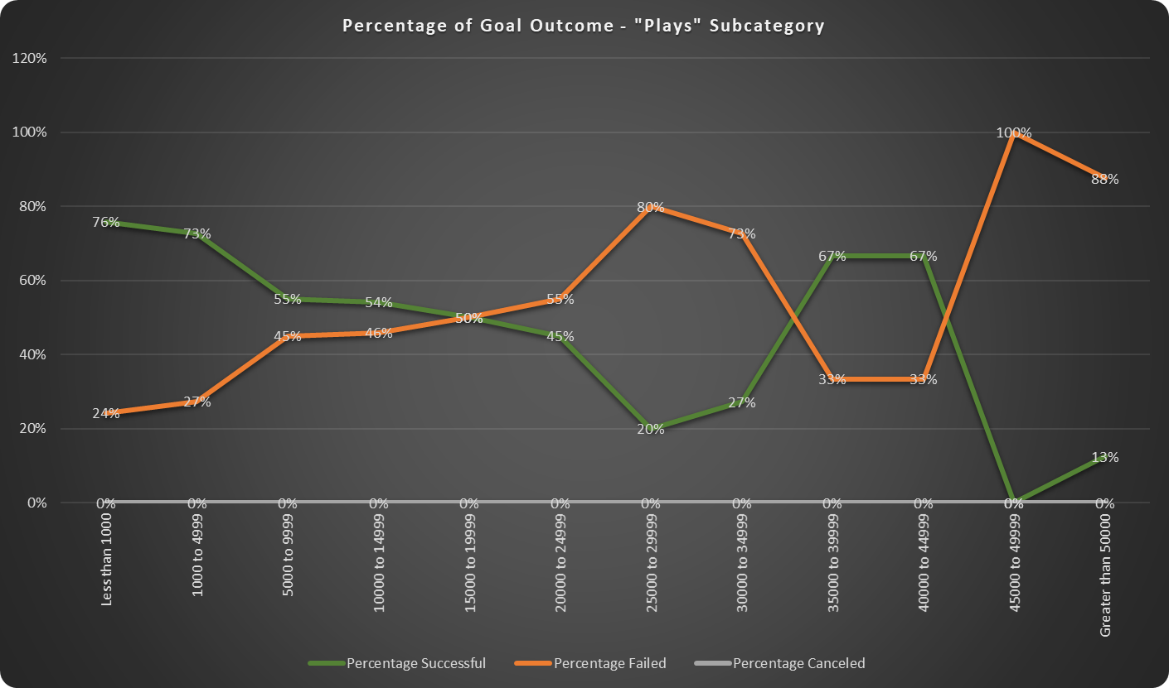
Outcomes Based on Goals
By grouping the goals we defined the ranges in which campaigns have more chances to be successful. This chart shows four buckets:
‘Less than 1000’
‘from 1000 to 4999’
‘from 35000 to39999’
‘from 40000 to 49999’
But we have to take a closer look at these ranges to ensure that they are indeed so popular for investments.

Slide 3
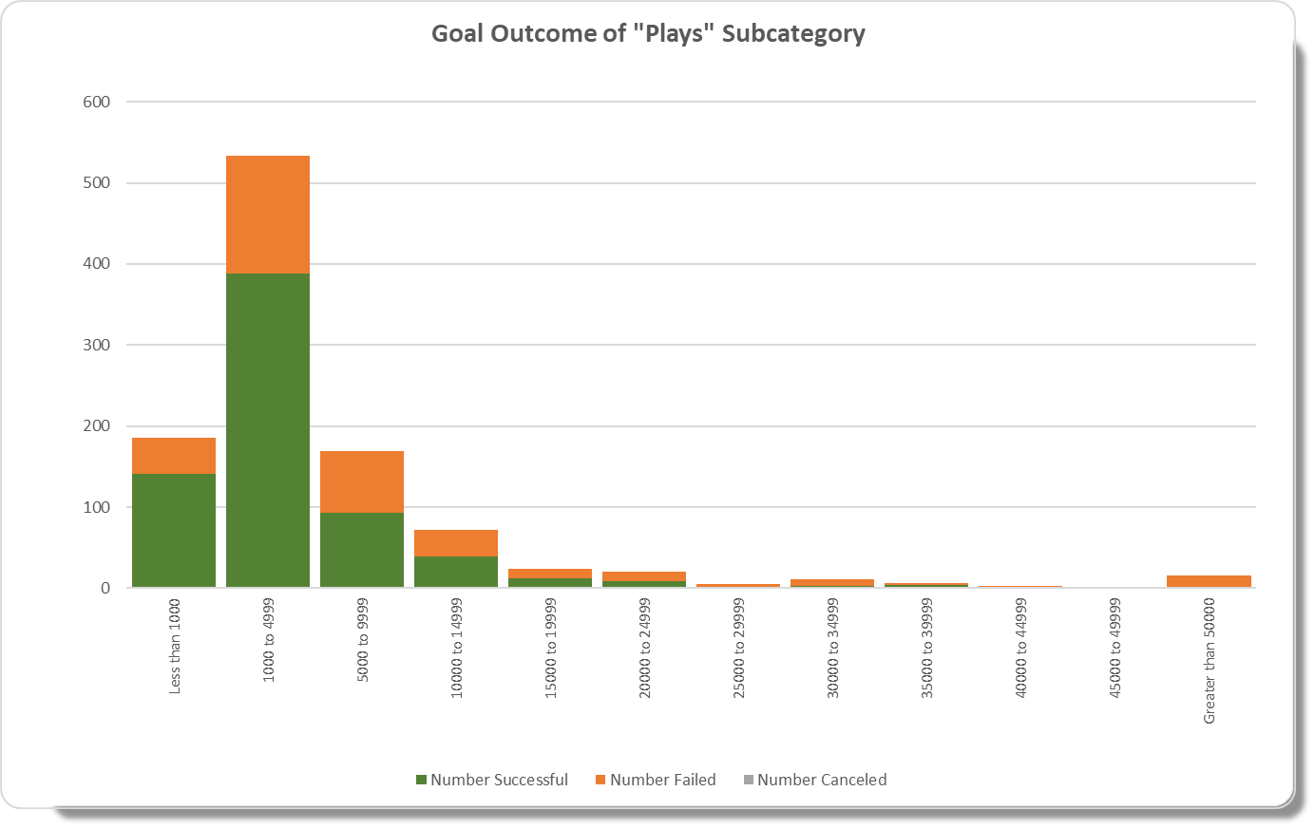
Outcomes Based on Goals - continue
In this chart we can really see that the biggest numbers of investment is falling in one range:
‘from 1000 to 4999’
So we can make a conclusion that the percentage of projects falling into each category is not enough for defining a range of goals. Clearly, there are very few projects in the big goal ranges.
But what if our project has a big budget and we need to raise a lot of money? We need to do more investigation on our chances of success.

Slide 4
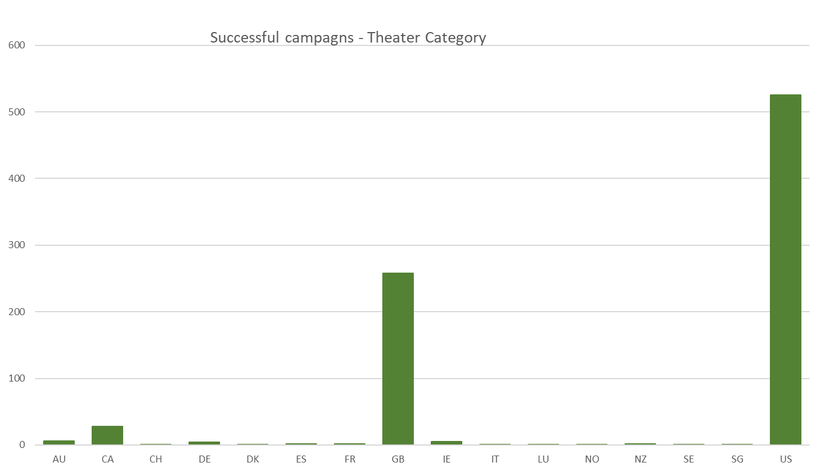
In which countries are people most likely willing to donate to ‘Theater’?
According to our data set the most popular countries with ‘Theater’ campaigns are The United States and Great Britain.
We will use the data of these locations for our analysis.

Slide 5
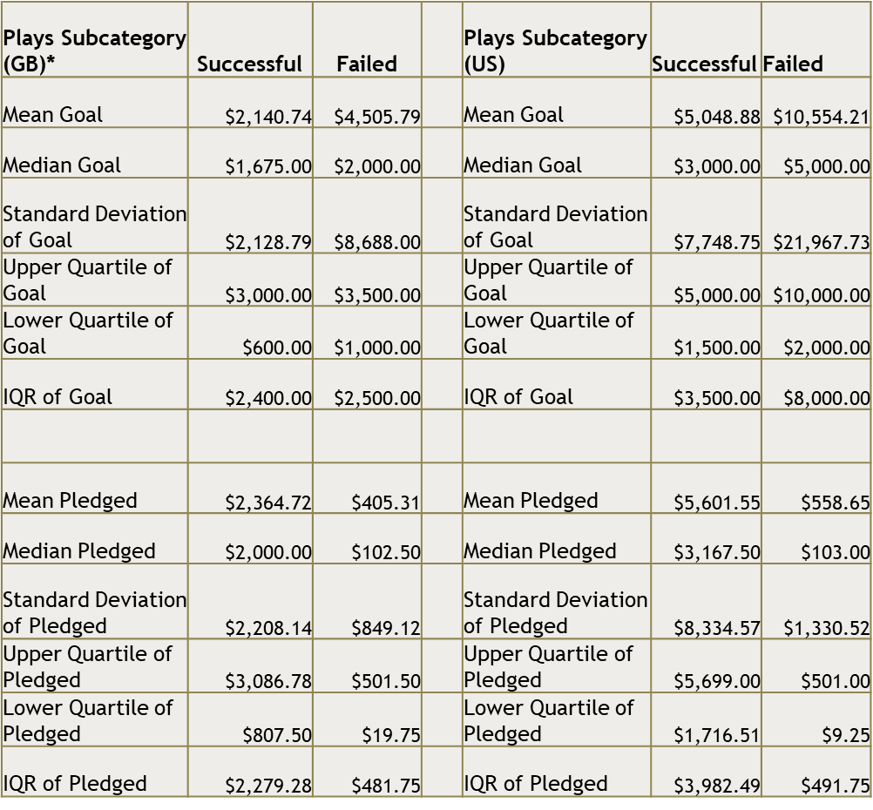
Analyzing Statistics
In Great Britain the average successful pledge is around $2.2K which meets the goal, and 50% of all successful projects are falling between $0.8K and $3K. For failed campaigns the average goals are much higher than successful projects, and the Standard deviation is 3.5 times as much as InterQuartile Range which means that there are some very big goal projects. But it may not be the reason for failure because the 50% of the projects are falling in almost the same range as successful do, which means that there are projects with similar goals but different result.
In the US the pledge of successful campaigns is much higher - $5.6K, and this amount is significantly above median which means that there are some projects with really high goals which doesn’t stop them from being successful. Does it mean that there are more people in America that are willing to donate more in ‘Theater’ campaigns? Or are they willing to donate more?
* Comparing or combining different countries in Analysis we should consider their currency (convert any currency to the US dollar). In our case we assume that US $ and GBP are equal

Slide 6
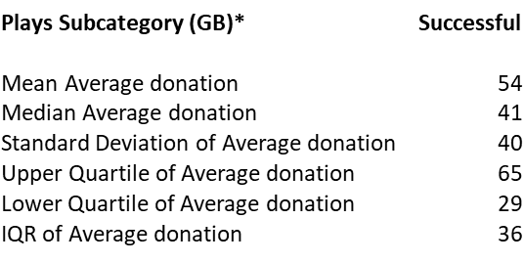
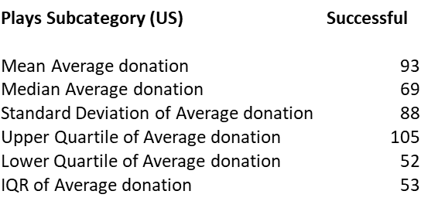
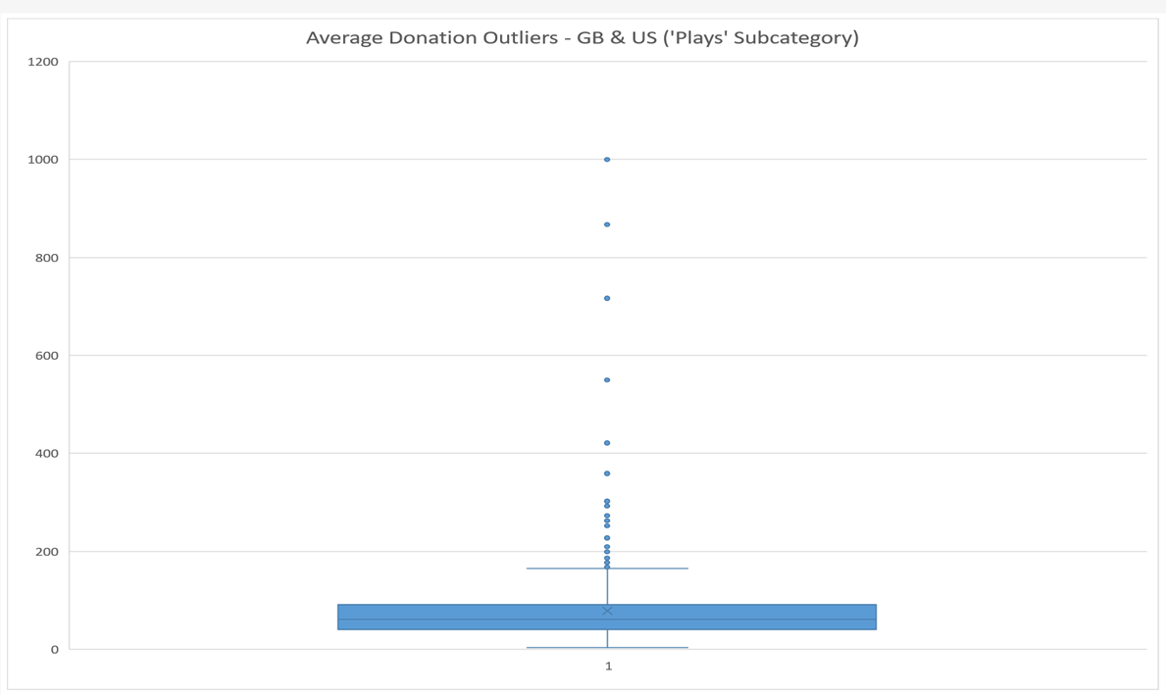
How much do people want to donate?
The average donation for two locations are slightly different – in the US average is 1.7 times as much as in GB.
Majority of the projects in GB have average donations falling between $65 and $29 per person while in the US it is between $105 and $52.
Yes we could say that people are more likely to donate not more than $100 which is also clear from the chart with outliers that are surely defined as anything above $170. But it may not be the reason for failure.
* Comparing or combining different countries in Analysis we should consider their currency (convert any currency to the US dollar) In our case we assume that US $ and GBP are equal

Slide 7
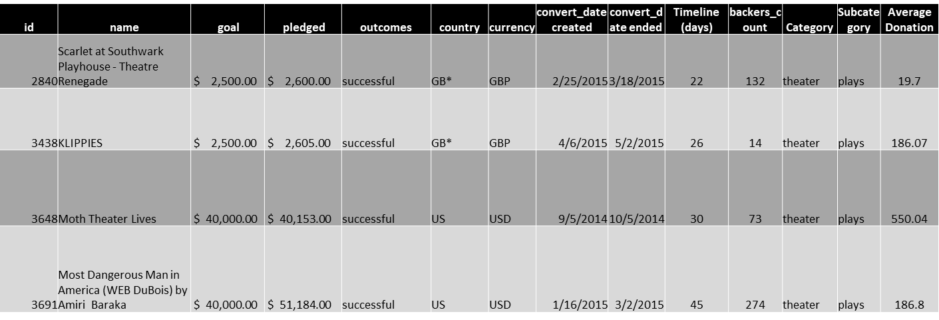
Comparing similar goals
As we can see from this table similar targets of two campaigns can have different contribution per person which means that asking a high price doesn’t necessarily mean failure. There could be some other reasons why people don’t mind paying a lot in some cases and why they don’t want to give even a small amount for other cases.
* Comparing or combining different countries in Analysis we should consider their currency (convert any currency to the US dollar)

Slide 8
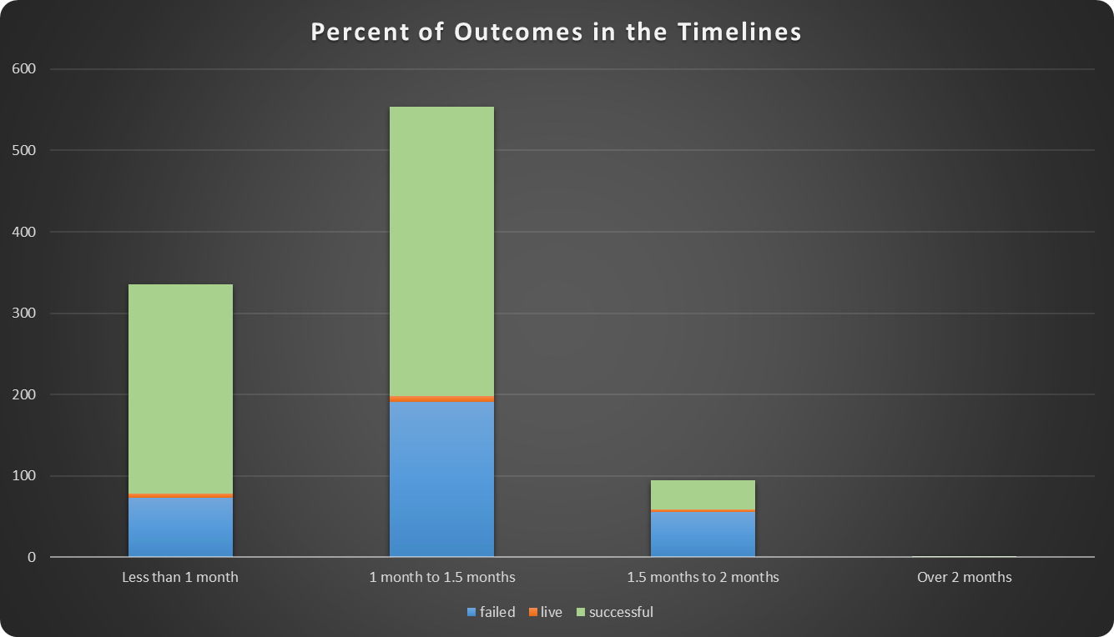
Maybe there is a correlation with the campaign duration?
Probably not. All of the ‘Play’ campaigns had been finished within two months. As we can see from the chart, during all this timelines there were successful and failed projects. This means that the outcome doesn’t depend on a project duration.
But what about particular time of a year?

Slide 9
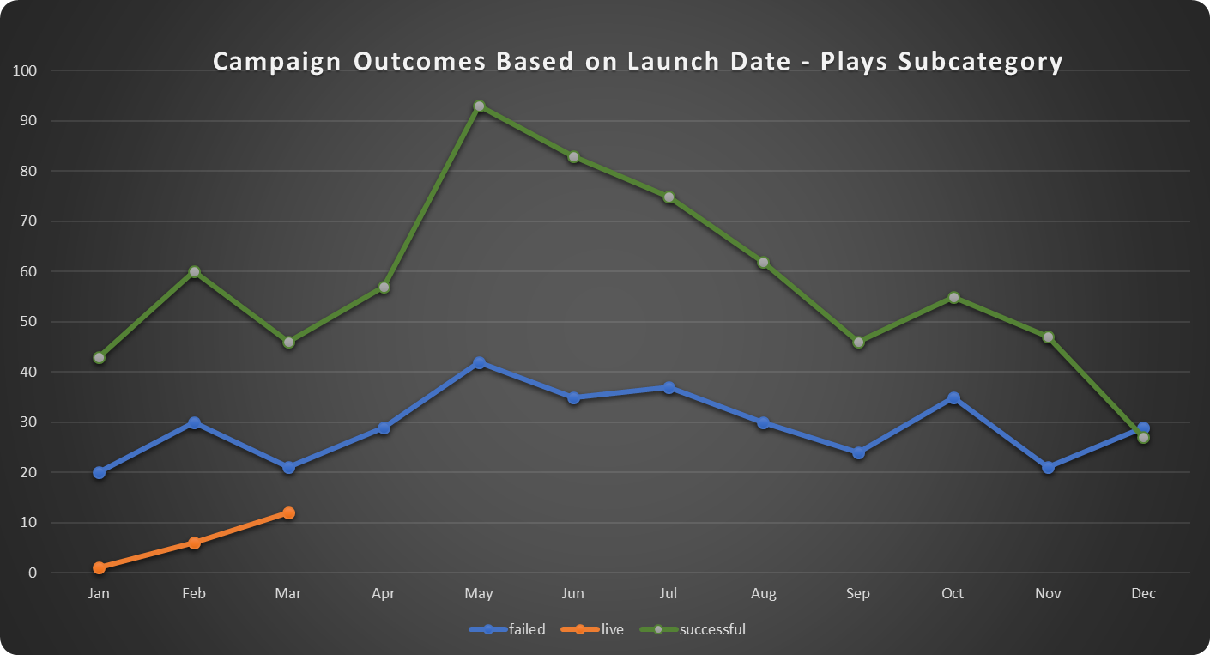
Season Impact
According to this graph we have more chances for success in May

Slide 10
Conclusion
We can see that seasons can impact the outcome
There is no correlation between the outcome and campaign duration
Percentage charts may visualize very good the relation between the goal and outcome but it will not be enough to reflect the full picture and can drive wrong conclusion. Thus, it has to be supported with a values visualization
We need to take in consideration locations (different countries have different areas of interest)
People are more likely to donate under $100 but a high price may not necessarily cause failure
Majority of the projects are falling in the range between $1000 and $5000 with a high chance of success but there are still campaigns with very high targets which were successful
For driving a decision there is not enough information in the given data set. We were not able to find out why people pay or not pay a big price because we do not know conditions of pledge for each project. Also, there is no information regarding the area of interest in which people want to invest the most (comedy, drama, etc or they like particular shows). Maybe they would want to donate bigger money for something that they passionate about.
The lack of information regarding those project that require a bigger budget but recognized as not profitable also gives us a limitation in analysis. So maybe it could explain why there is very few projects with high goals.
Moreover, we would want to understand why seasons have an impact on the campaigns, but for that we need to do more investigation in other sources.

